Slide 1


PropertyGuru (PG) Proposal Technical Walkthrough
26th July 2023
July 2020
Notes:
Plug in intro

Slide 2


Our Understanding of the Requirement
Solution Architecture
Assumptions and Dependencies
Project Management
Execution & Governance
Milestone
AGENDA

Slide 3


Requirement & Scope

Slide 4
Our Understanding of the Requirement – Shantanu
All the identified features are grouped under 12 Microservices ( Listing Management Service ,Listing Search Service , Agent Subscription Service ,Agent Management Service , Users Service , Mobile BFF , Admin Service (Frontend) , User Engagement – Enquiry , Advertising , Developer (Database Dependencies) , Info Service and Email Template Management )
All the in-scope marketplaces should be able to use the identified microservices for their workflows
Features are identified based on 3 persons ( Admin, Agent and End Customer) for all marketplaces.
Marketplaces analyzed - PG marketplaces in Singapore, Thailand, Malaysia, and Indonesia
Integration Points: Salesforce ,
Slide 4

Slide 5
In Scope and Out of Scope – Srinath
In Scope
Out of Scope
User Experience (UX)
Functional Testing
User Acceptance Testing Support
Performance Testing and
Application Security Testing
Infrastructure Set Up & basic pipeline (2 environments)
Language Support – English only
Warranty Support (2 weeks)
Test Automation
Security Testing (PEN)
Accessibility
User manual, SOP, Runbook documentation
Beta features

Slide 6
Proposed Approach

Slide 7
System Architecture – Dinesh and Santhosh
Design Considerations for Migrations
Modernization strategy
Technical Details - Services Transformations
Backward compatibility
Data Migration Considerations
Target Architecture
The above architecture diagram depicts high level architecture of the solution. The application will be deployed in AWS Cloud.

Slide 8
System Architecture Contd…
Design Considertations
Slide 8

Slide 9
Testing Approach - Madhu

Slide 10
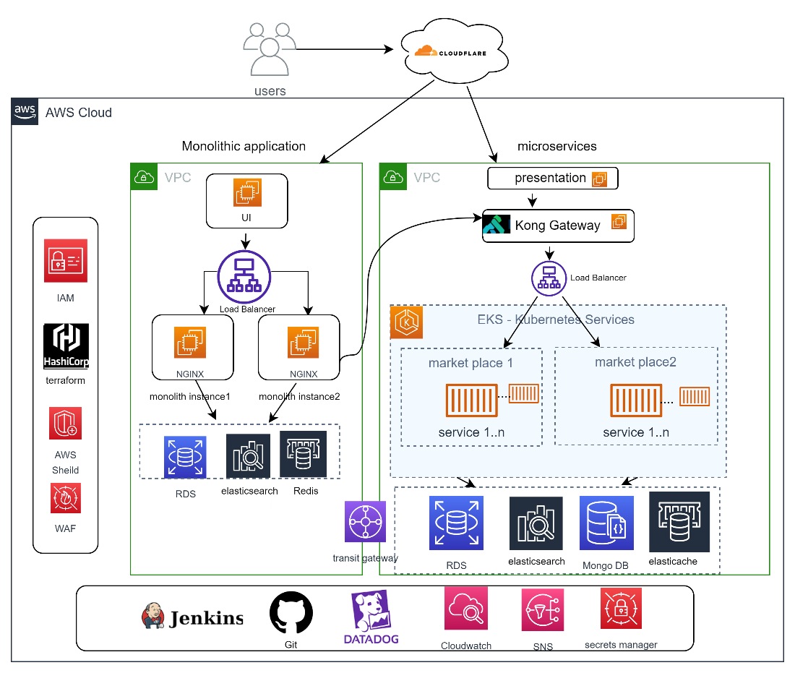
DevOps Approach - Madhu
The above architecture diagram depicts the high-level architecture of the solution. The application will be deployed in AWS Cloud.

Slide 11
High level Approach
The implementation plan will include the following steps:
Setting up the AWS environment (VPC, subnets, security groups)
Defining Terraform scripts for provisioning infrastructure components.
Configuring EKS cluster with auto-scaling and worker nodes
Creating the RDS instance and connecting it to the EKS cluster
Developing React JS-based UI and deploying it to S3.
Configuring API Gateway to manage API endpoints.
Setting up Jenkins pipelines for CI/CD
Implementing monitoring, logging, alerting, and disaster recovery mechanisms

Slide 12
High level Approach
Infrastructure as Code (IaC) Practice and Automation: The infrastructure will be defined as code using Terraform, enabling consistent and repeatable provisioning of AWS resources. This approach ensures the entire infrastructure is version-controlled, allows for easy tracking of changes, and simplifies collaboration.
CI/CD Approach: For continuous integration and continuous deployment (CI/CD), we will utilize the following tools and practices:
Code repository: GitHub for version control and collaboration.
Build and dependency management: Apache Maven or Gradle for building the Spring Boot microservices and React JS application.
Containerization: Docker will be used to containerize the microservices.
Container Registry: AWS Elastic Container Registry (ECR) will be used to store and manage Docker images.

Slide 13
High level Approach
Continuous Integration and Deployment: Jenkins will be used to establish a robust CI/CD pipeline. It will integrate with the version control system (e.g., Git) to trigger automated builds, perform code quality checks, execute tests, and deploy the applications to the EKS cluster. Jenkins pipelines will be defined using declarative syntax for easy maintenance and scalability.
Infrastructure Updates: Infrastructure updates will be handled using Terraform, triggered by the Jenkins CI/CD pipeline.
Monitoring and Logging:
To monitor the deployed infrastructure and applications, we will implement the following:
Application Logging: We can integrate Grafana Loki, a log aggregation and search system, with your EKS cluster. Grafana Loki helps you collect and store logs from various sources within your EKS cluster, including application logs, container logs, and system logs.

Slide 14
High level Approach
Disaster Recovery:
To ensure high availability and disaster recovery, we will implement the following measures:
EKS Multi-AZ Deployment: The EKS cluster will be deployed across multiple Availability Zones (AZs) to achieve redundancy and fault tolerance.
Automated Database Backups: AWS RDS with Mango DB supports automated backups, allowing us to easily restore data in case of a failure.
Cross-Region Replication: For critical workloads, we can set up cross-region replication of the RDS database to a different AWS region, ensuring data redundancy and disaster recovery.

Slide 15
Technical Stack – Indicative – Dinesh and Santhosh
Features | Technology
User Interface
Backend
Cloud
API Gateway
Microservices
Database/Storage
Notification & Queue

Slide 16
Assumptions and Dependencies

Slide 17
Assumptions – Srinath
Any enhancement to existing features/ business use case need to be discussed during the project During the entire project cycle, any new feature introduced need to be evaluated and estimated separately

Slide 18
Dependencies on PG – Srinath
Dependency Factors | To be available by
Product owner for the knowledge transition of the application, clarification, and review of the user stories | Start of the project
Technical SPOC for feedback and clarifications | Start of the project
Provide any coding guideline or standards that happiest minds must follow for development | Start of the project
Email/Notification format and content | Start of the project
Master data (Products and components) | Start of the project
Code repository access (Git Repo) | Start of the project
Review UAT Test Case document | As needed during the project
Response to Happiest Minds’ queries within two business days. Any delays in response might have an impact on the effort and schedule & will be treated as a Change Request, | As needed during the project
Feedback on the deliverables for each milestone must be provided within 3 days of the delivery by Happiest Minds, else, they shall be deemed accepted | During entire project engagement
Multilingual content to be provided by PG | During entire project engagement

Slide 19
Risk and Mitigation – Srinath

Slide 20
Tentative Schedule - Milestones

Slide 21
Tentative Execution Schedule and Milestones
Below is High level schedule, more details will be added post the initial discovery phase
Milestone | Service List / Deliverables | Schedule (Months) | Remarks
Discovery | Discovery Phase | T + 2 | Validation of domains and dependencies High level Architecture validation Detailed Project Plan
Milestone-1 | Framework / Common building blocks Auth Service Info Service | T + 5
UAT-1 | UAT of Milestone-1 |  | 4 weeks of UAT

Slide 22
Commercials

Slide 23
Afshan Momin
Client Partner – MSIL
Afshan Momin afshan.momin@happiestminds.com
+91 9890920405

